Slide 1
Blue Team Report
Final Project Week
1

Slide 2
Items we will cover in this report
Current Network Topology
Alerts Implemented
Hardening/Mitigation
Questions

Slide 3
Network Topology

Slide 4
HostName | OS | IP Address | Purpose
ML-RefVm-684427 | Windows 10 | 192.168.1.1 | Hyper-V Host
Kali | Kali Linux 2020.1 | 192.168.1.90 | Attacker Machine
Target 1 | Debian Linux 8 | 192.168.1.110 | Wordpress/Target Machine
Capstone | Ubuntu Linux 18.04 | 192.168.1.105 | Log forwarder
ELK | Ubuntu Linux 18.04 | 192.168.1.100 | ELK Stack Server

Slide 5
Alerts Implemented

Slide 6
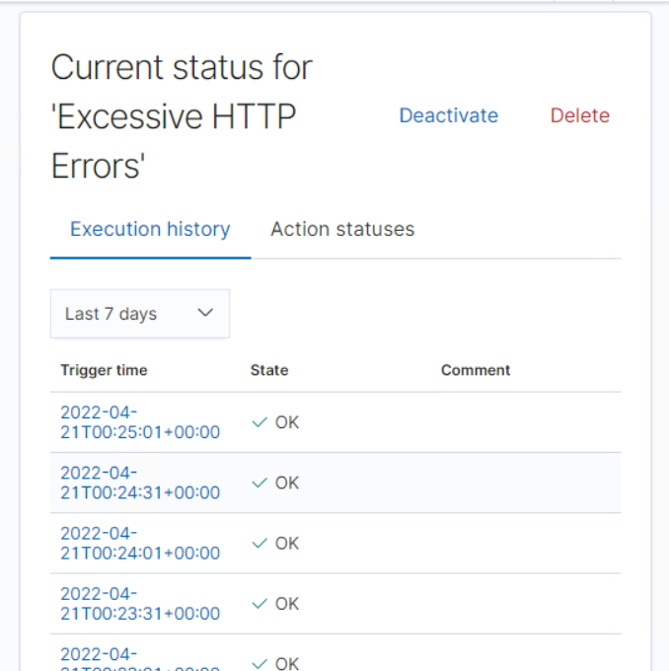
Alert 1: Excessive HTTP Errors
Implementation
Visualization
- Metric: http.response.status_code
- Threshold: 400
Vulnerability Detected: Brute Force Attack
Reliability: High

Slide 7
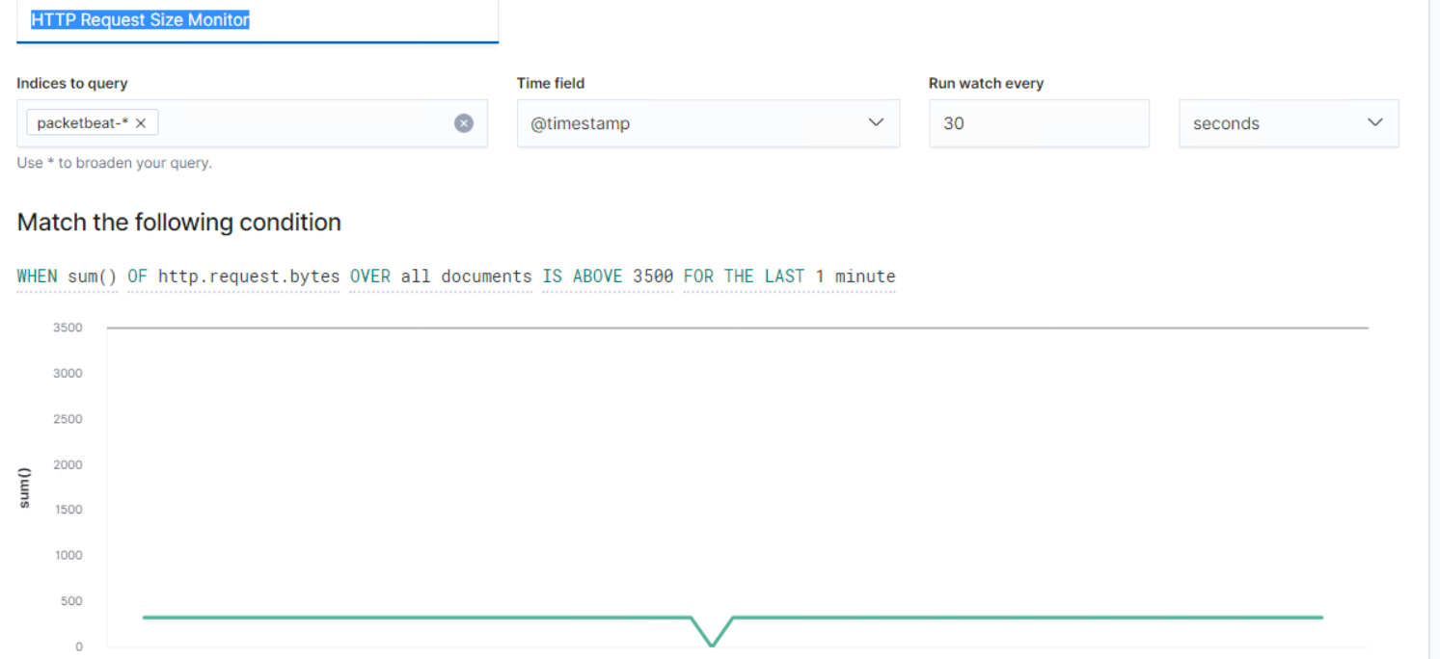
Alert 2: HTTP Request Size Monitor
Implementation
Visualization
- Metric: http.request.bytes
- Threshold: 3500
Vulnerability Detected: Code injection in HTTP requests (XSS and CRLF) or DDOS
Reliability: Medium

Slide 8
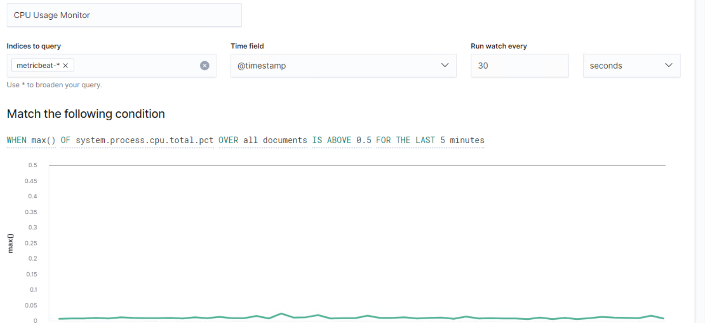
Alert 3: CPU Usage Monitor
Implementation
Visualization
- Metric: system.process.cpu.total.pct
- Threshold: .5
Vulnerability Detected: Virus/Malware or DDOS
Reliability: High

Slide 9
Hardening

Slide 10
Vulnerability: Wordpress Brute Force Attack
Implementation
Mitigation
a brute-force attack is a trial of each and every possible combination of username and password to bypass the website admin login. These attacks are called brute-force because they use extensively forceful methods to break in. Unlike other attacks, they don’t rely on the weaknesses or vulnerabilities of the website. Instead, they prey on easy passwords, unlimited login attempts, etc.
1. Use strong login credentials
2. Hide WordPress login page
3. Two-factor Authentication
4. Limit login attempts
5. Whitelisting Access

Slide 11
Vulnerability: Code injection in HTTP requests (XSS and CRLF) or DDOS
Implementation
Mitigation
Code Injection:
An object injection vulnerability occurs when you fail to sanitize user-supplied input correctly before passing it to the unserialize() PHP function. Since PHP permits object serialization, attackers can potentially pass ad-hoc serialized strings to an unserialize() call. This may result in arbitrary PHP object(s) being injected into your application’s scope.
DDOS:
DDoS attack, short for Distributed Denial of Service attack, is a type of cyber attack that uses compromised computers and devices to send or request data from a WordPress hosting server. The purpose of these requests is to slow down and eventually crash the targeted server.
Keep WordPress Core Up-to-Date
Use a Web Application Firewall
Sanitize Your Data
Disable XML RPC in WordPress
Disable REST API in WordPress

Slide 12
Vulnerability: Virus/Malware
Implementation
Mitigation
Common web coding languages like PHP and Java allow programmers to refer to external files and scripts from within their code. The “include” command is the generic name for this type of activity.
In certain situations, a hacker can manipulate a website’s URL to compromise the “include” section of the code and gain access to other parts of the application server. Certain plug-ins for the WordPress platform have been found to be vulnerable against file inclusion attacks. When such hacks occur, the infiltrator can gain access to all data on the primary application server.
Keep WordPress Core Up-to-Date
Use a Web Application Firewall
Sanitize Your Data
Disable XML RPC in WordPress
Disable REST API in WordPress
Install a Virus Scanner

Slide 13
Questions?

